Slide 1

Monthly Usage and Demand Analysis
By. Ethan Tornga

Slide 2
The Data
Identifier
(15.61k unique values)
Usage
(Highest in Feb. ‘25)
Demand
(Highest in Sept. ‘24)
Year and Month

Slide 3
Analysis
Python
R
Power BI

Slide 4
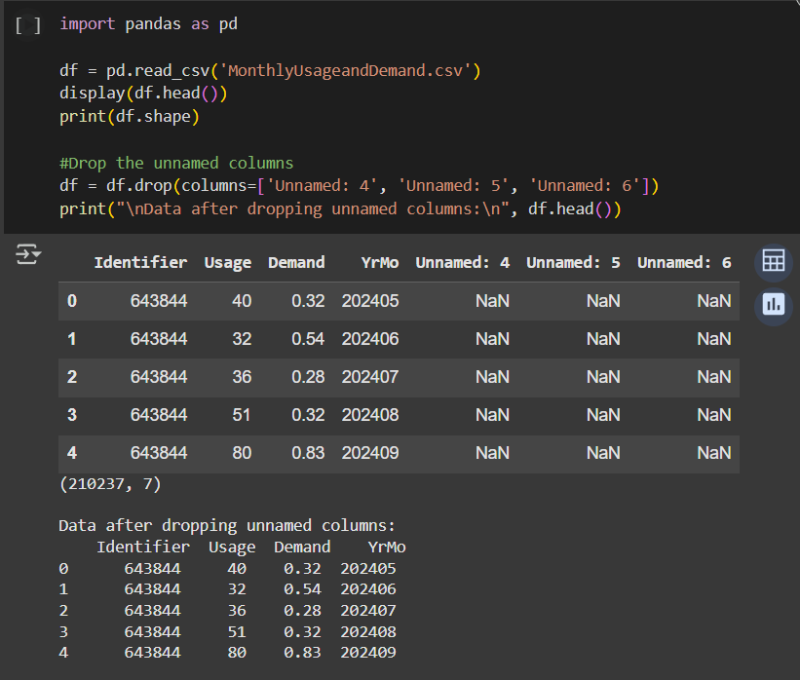
Loading and Initial Cleaning

Slide 5
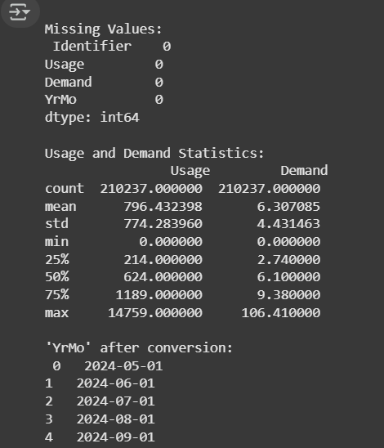
Data Cleaning

Slide 6
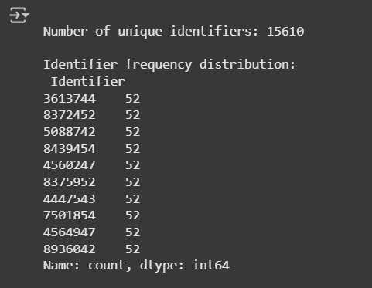
Identifier Analysis

Slide 7
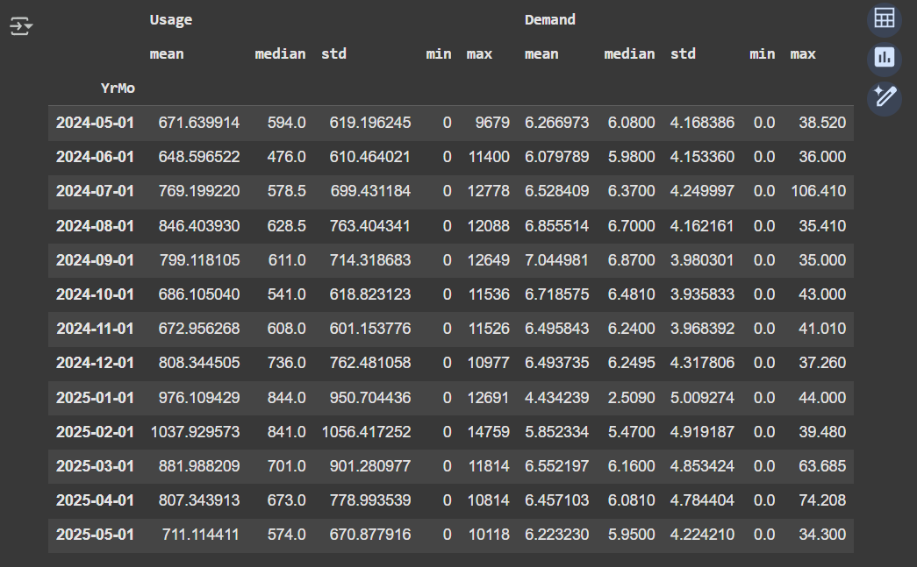
Usage and Demand Statistics

Slide 8
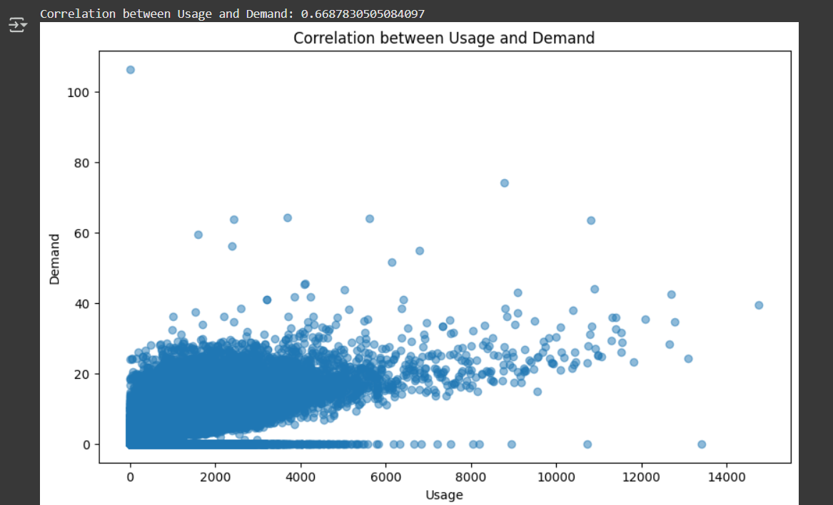
Correlation between Usage and Demand
Notes:
Positive Correlation

Slide 10
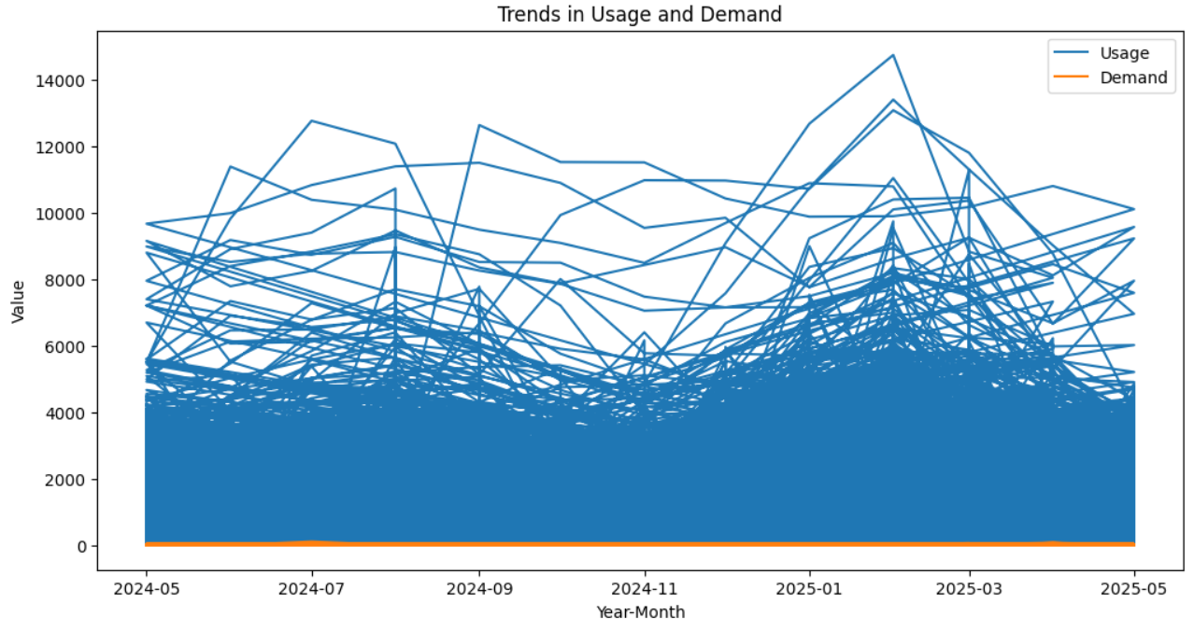

Slide 11
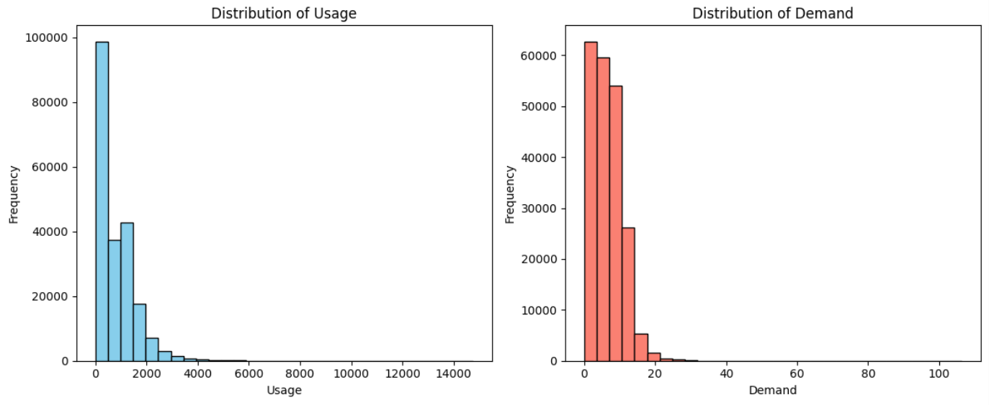

Slide 12
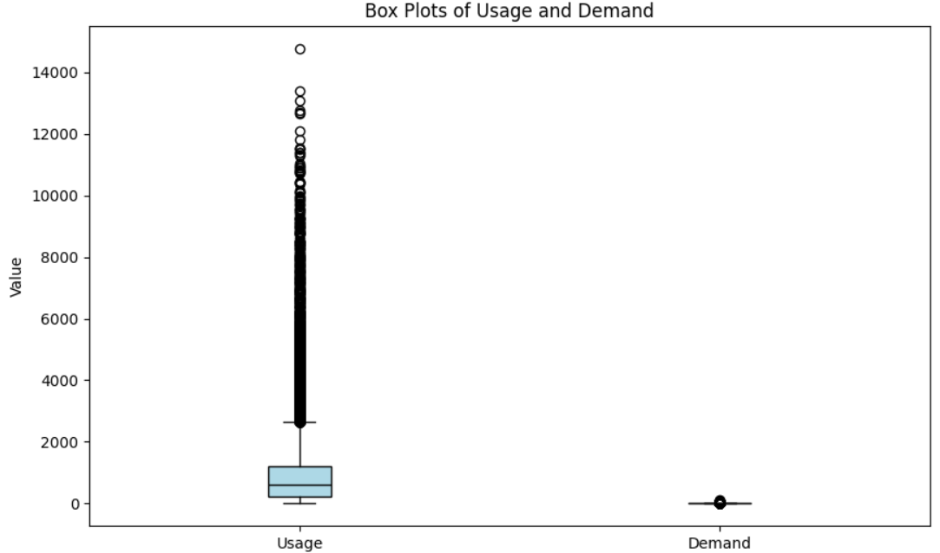

Slide 13
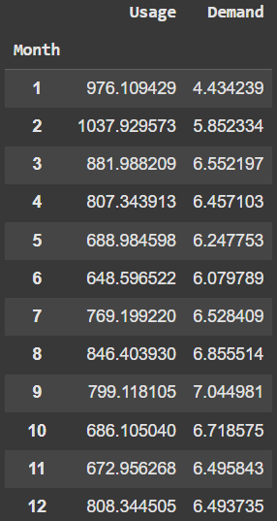
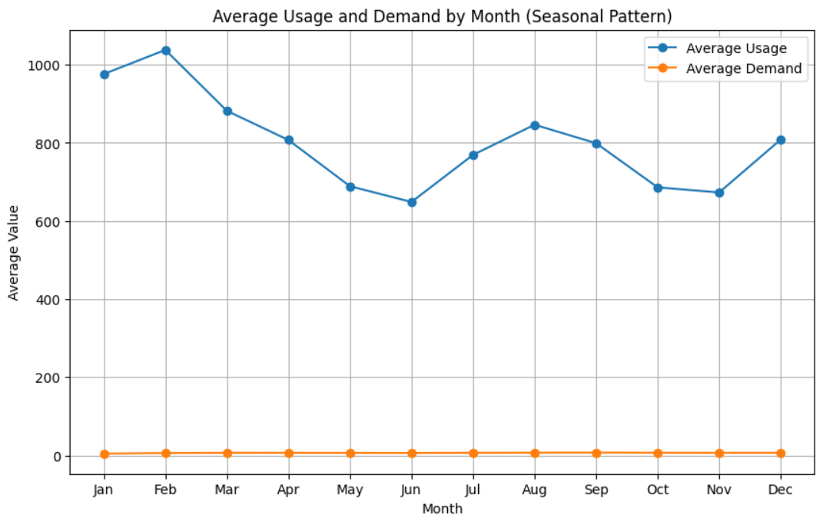

Slide 14
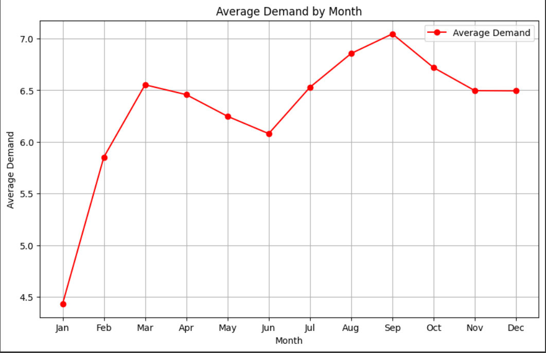

Slide 15
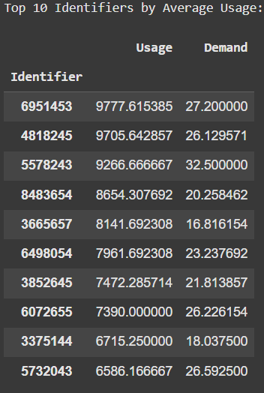
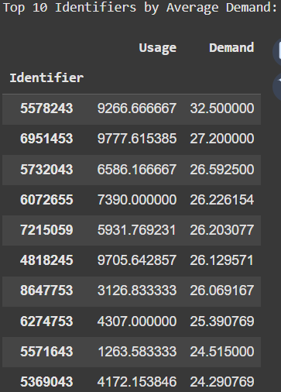

Slide 16
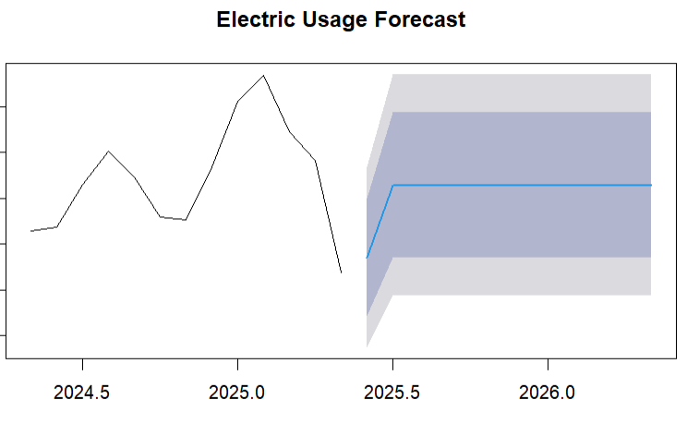
ARIMA Forecasting

Slide 17
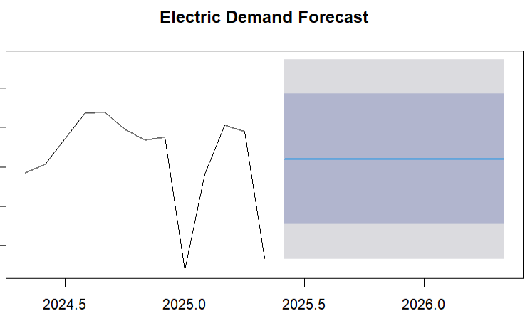
ARIMA Forecasting

Slide 18
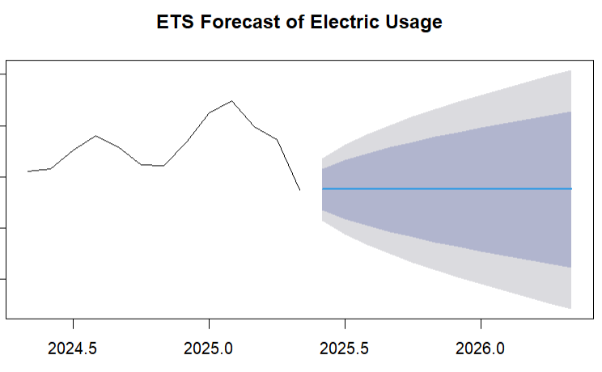
ETS Forecasting (12 Month)

Slide 19
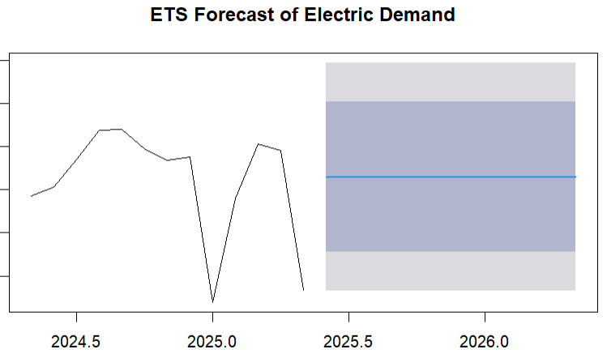
ETS Forecasting (12 Month)

Slide 20
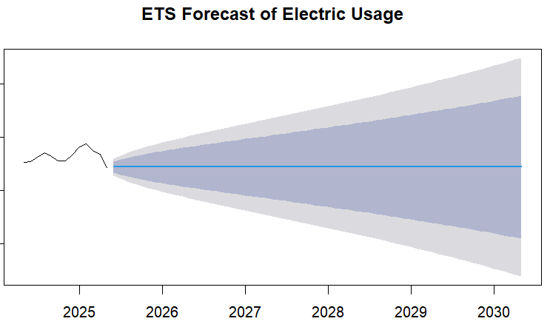
ETS Forecasting (5 Years)

Slide 21
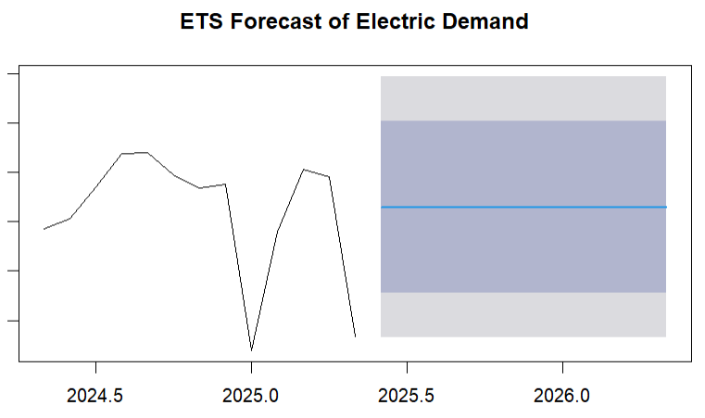
ETS Forecasting (5 Years)

Slide 22
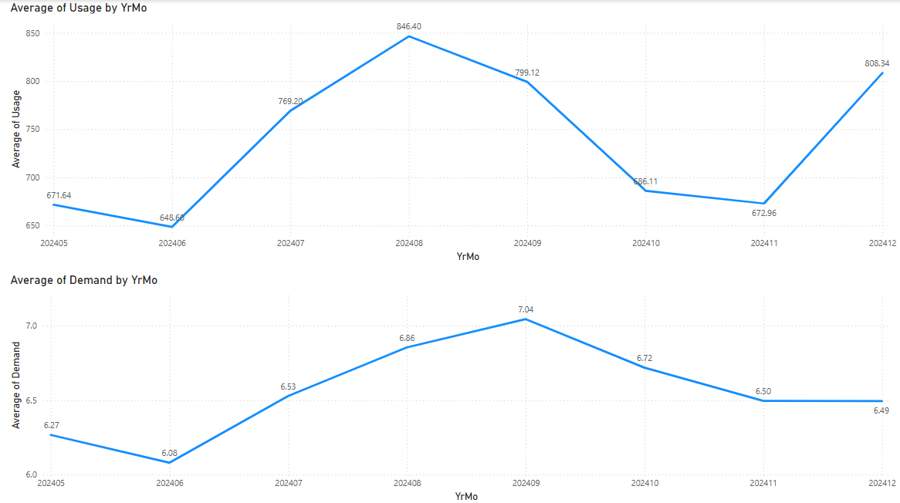
Usage and Demand in 2024

Slide 23
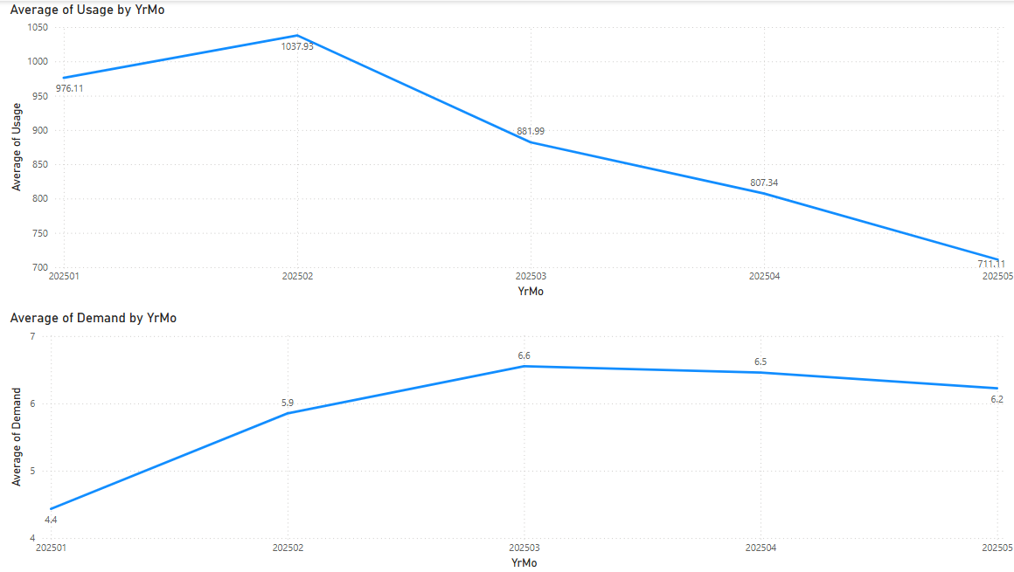
Usage and Demand in 2025

Slide 24
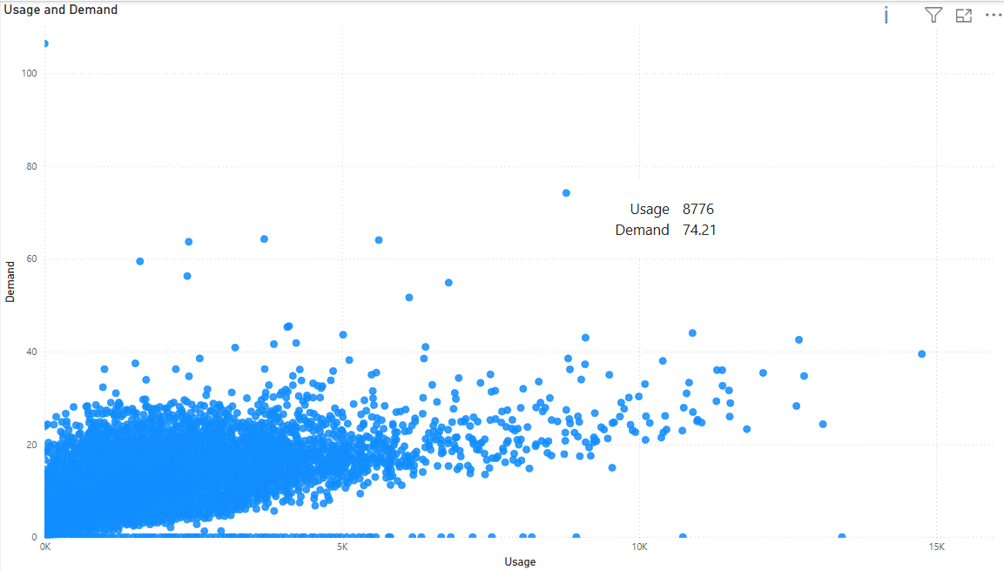
Usage and Demand (Power BI)

Slide 25
Why Is This Information Helpful?
Key insights into member trends
Preparing for future months/long-term future
Determine the impact that Usage and Demand have on each other
Helps gain a better understanding of operations, in turn helping members receive better services

Slide 26

Thank You For Your Time!
Any Further Questions?

